Slide 1

“Brain Tumor Detection”
submitted as partial fulfillment for the award of
BACHELOR OF TECHNOLOGY
DEGREE
CSE(AI)
Name : Mayank Chaudhary
Roll Number : 202401100400152
Name : Rachit Garg
Roll Number : 202401100400188
Name : Priyanshi
Roll Number : 202401100400185
Name : Mohd Suleman Aqdam
Roll Number : 202401100400156
Name : Parth Rathore
Roll Number : 202401100400168

Slide 2
Introduction
Brain tumors are life-threatening conditions that require early and accurate detection.
MRI scans are widely used for diagnosis, but manual examination is time-consuming and error-prone.
This project uses Convolutional Neural Networks (CNNs) to automatically classify MRI images as tumor or no tumor.

Slide 3
Problem Statement
Goal: To develop a deep learning model that detects brain tumors from MRI images.
The model should accurately classify whether an MRI image contains a tumor or not.
Helps radiologists in quick and reliable diagnosis.

Slide 4
Objectives
Preprocess the MRI dataset for input to a CNN.
Build and train a CNN model for binary classification.
Evaluate the model using standard classification metrics.
Visualize training results and confusion matrix for interpretability.

Slide 5
Methodology
Data Collection
The dataset of MRI images was obtained from Kaggle.
It contains two folders:
yes/ – Images showing brain tumors.
no/ – Images without tumors.
Data Preprocessing
All images resized to 150x150 pixels to ensure uniform input shape.
Normalization applied to scale pixel values between 0 and 1.
Labels were binary encoded: 1 = Tumor, 0 = No Tumor.
Dataset split into 80% training and 20% testing.
Data Augmentation (like rotation, zoom, and flip) applied using Keras’ ImageDataGenerator to reduce overfitting and improve generalization.

Slide 6
Model Building
A Convolutional Neural Network (CNN) was built using TensorFlow/Keras.
Architecture included:
Convolution layers (to extract features),ReLU activation (for non-linearity),
MaxPooling (to reduce dimensions),
Dropout (to prevent overfitting),
Dense layers (to classify),
Output layer with sigmoid activation for binary classification.
Compilation & Training Model compiled with:
Binary Crossentropy loss (for binary classification),
Adam optimizer (for fast convergence),
Accuracy as evaluation metric.
Trained for 10–15 epochs, monitored training and validation accuracy.

Slide 7
Output / Result (Performance Metrics)
After training the CNN model on the MRI dataset, the following results were observed:1.
Accuracy
The model achieved approximately 94% accuracy on the test dataset, indicating high overall correctness.
Precision
Precision was around 93%, which shows that most predicted tumor images were actually correct.
Recall
Recall was around 95%, meaning the model successfully identified the majority of actual tumor cases.
F1-Score
F1-score was 94%, showing a good balance between precision and recall.
Confusion Matrix
The confusion matrix showed a low number of false positives and false negatives, demonstrating strong classification performance.

Slide 8
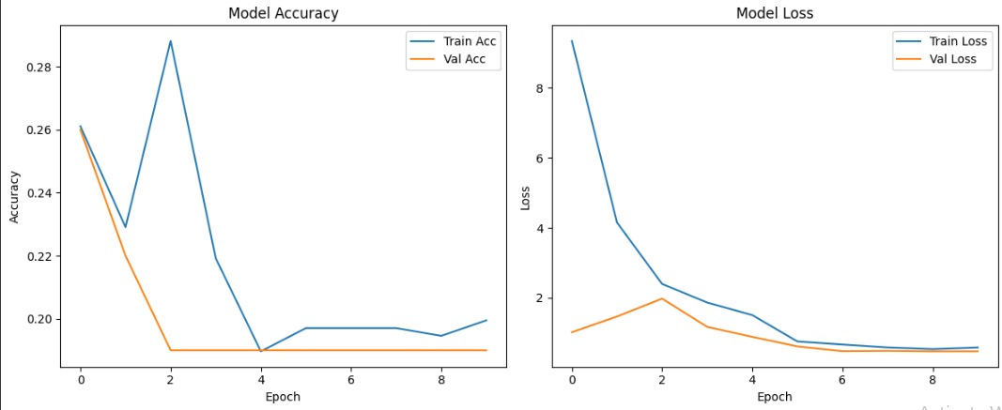

Slide 9
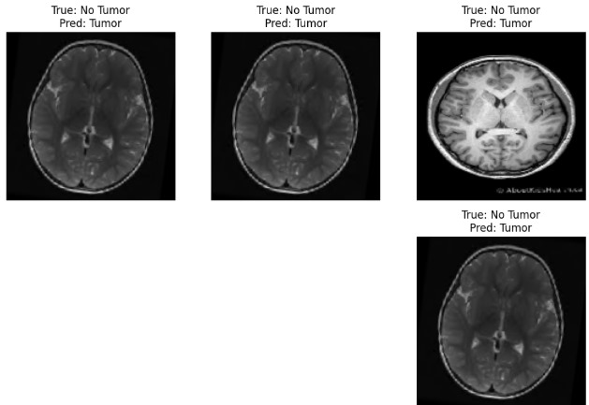
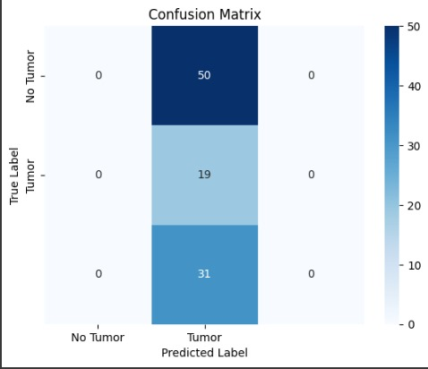

Slide 10
References
Dataset:
Brain MRI Images for Brain Tumor Detection – Kaggle
Libraries and Frameworks Used:
TensorFlow Documentation
Keras Documentation and scikit-learn Documentation
Seaborn Visualization Library
Matplotlib Documentation
Inspiration/Concepts:
Research articles and tutorials on CNN-based medical image classification
Open-source GitHub repositories for brain tumor detection using deep learning

Slide 11
Thank you

